Slide 1

An internship Pre-Final defense on
Wind Horse Tours
Urgen Sherpa(3328)
Bsc.csit, 8th Semester

Slide 2


Slide 3

Halftone designs pvt. Ltd.
Provide services regarding graphic design, website designing, development and maintenance.

Slide 4

Wind horse tours
Tours, treks and travel operating company.

Slide 5

Problem Statement
Outdated design.
Lack of responsive theming.

Slide 6

internship Objectives
To experience and understand the work ethics, professional standard and technology used by an organization to achieve their goals.
To get knowledge and experience in handling real world project.

Slide 7
Project Objectives
To update the designs of the web application according to the latest trends.
To implement responsive theming.

Slide 8
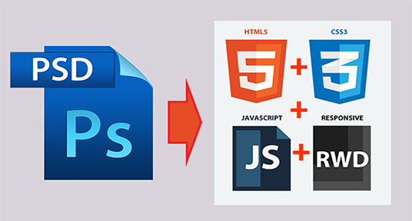
Psd to html conversion

Slide 9
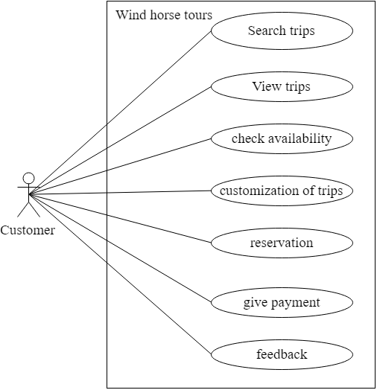
Use-case diagram (customer)

Slide 10
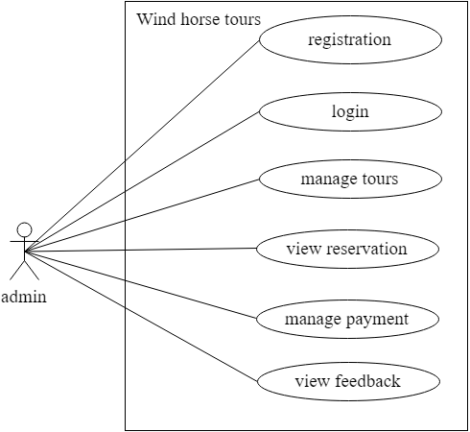
Use-case diagram (admin)

Slide 11
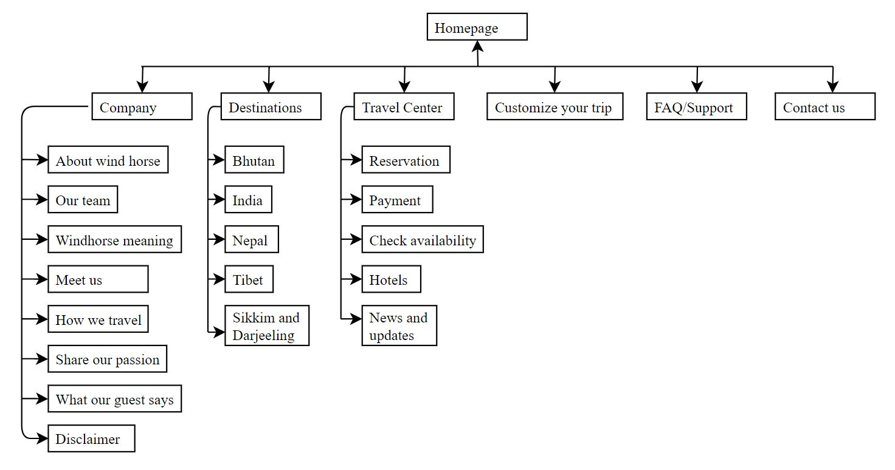
WEBSITE STRUCTURE

Slide 12
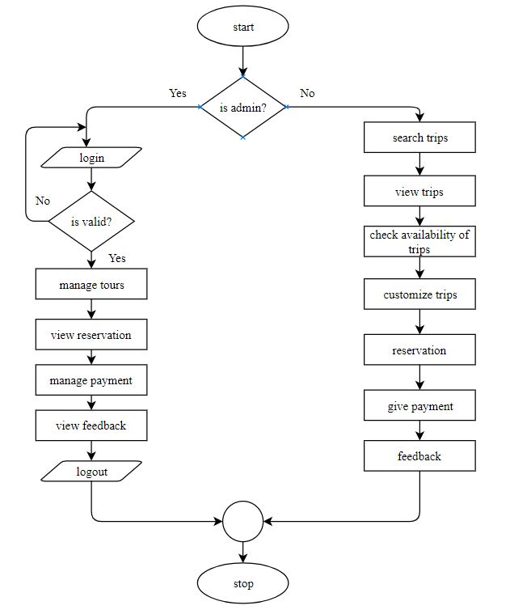
Flowchart of the application

Slide 13





FROnt-end technologies
Photoshop cc 2017
Sublime Text 3
Html5
Css3
JavaScript/Jquery

Slide 14




Back-end technologies
PHP
MySQL
Apache
InMotion Hosting

Slide 15

Testing
Unit Testing
Integration Testing

Slide 16
Front-end testing
Code validation
Cross-browser compatibility testing
Responsive Design testing

Slide 17

Code validation
Html5 validation: https://validator.w3.org/

Slide 18

Code validation
CSS validation: https://jigsaw.w3.org/css-validator/

Slide 19

Cross browser testing

Slide 20

Responsive design test
Google Chrome’s Devtools feature: device mode

Slide 21
conclusion
Conversion of PSD template of wind horse tours to html5/css3 is completed.
Responsive design has been implemented.
Code validation, cross browser testing is completed.

Slide 22
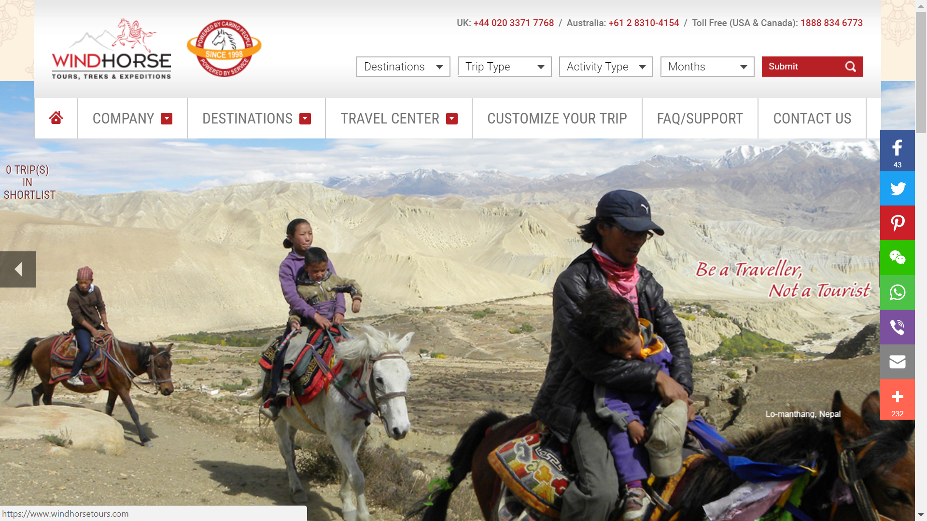

Slide 23
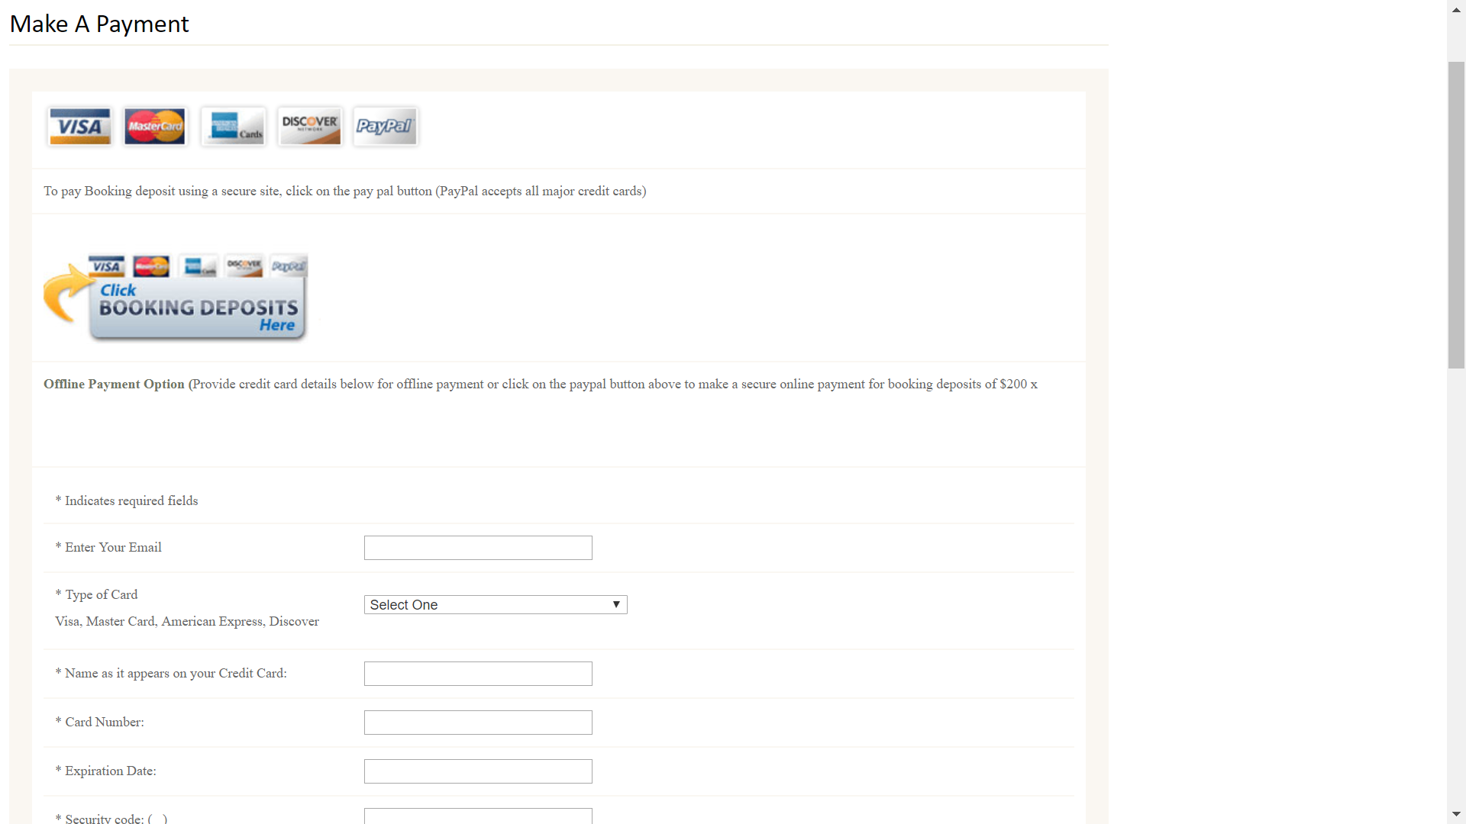

Slide 24
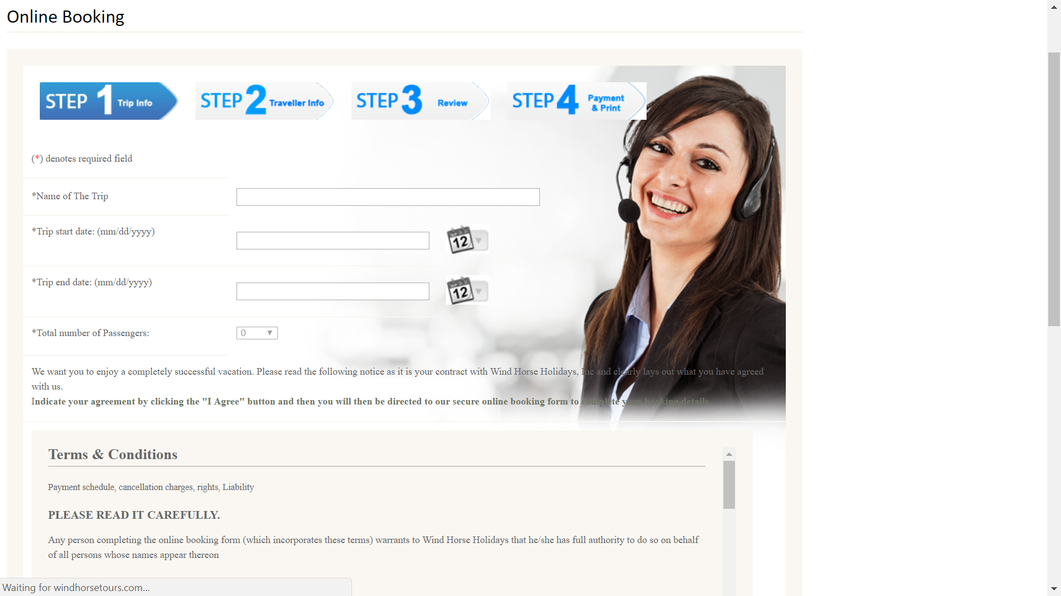

Slide 25
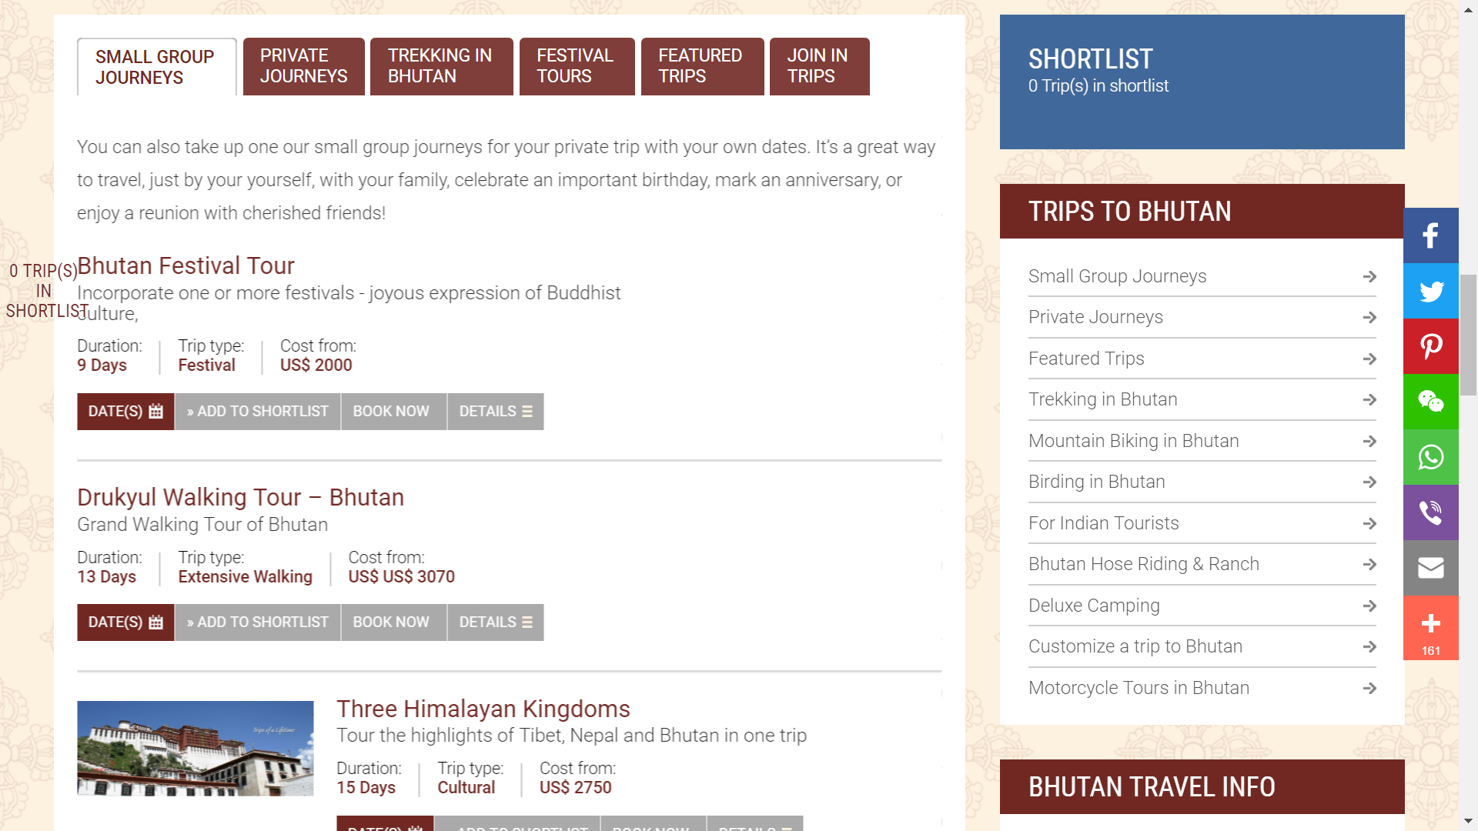

Slide 26
Thank you!!

